Slide 1

Project Phase I Presentation Brain Tumour Detection System Presented by Ishan Modi (N18018) Ishan Srivastav (N18068) Janhavi Panambor (N18057) Guided by DR. VARSHA DEGAONKAR
Dept. of Electronics and Telecommunication
Hope Foundation’s
International Institute of Information Technology Hinjawadi Pune

Slide 2
Outline
Introduction
Literature survey
Problem statement and Objectives
Proposed Methodology
Requirement analysis
Impact analysis
Professional Ethical practices to be followed
Result and Future Scope
References

Slide 3
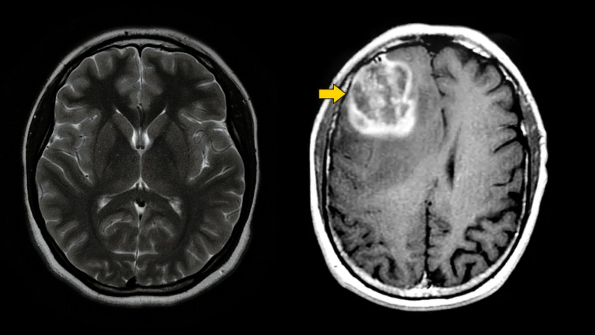
Introduction
The smart detection system operates on the AI algorithm.
It is based on image segmentation and object detection.
Early Detection of ‘Brain Tumor’.
Reduction of cost
Fig 1.- MRI Scan (researchgate.com)

Slide 4
Literature Survey
Name | Citation | Author | Method
Brain Tumour Detection Using Deep Learning | Seventh Interna- tional conference on Bio Signals, Images, and Instrumentation (ICBSII), 2021 | Avigyan Sinha, Aneesh R P, Malavika Suresh, Nitha Mohan R, Abinaya D, Ash- win G Singerji | Deep Learning
Pathways from symptoms to medical care: a descriptive study of symptom development and obstacles to early diagnosis in brain tumour patients | Family Practice, Volume 16, Issue 2, April 1999, Pages 143148 | Pr Salander, A Tommy Bergenheim, Katarina Hamberg, Roger Henriksson | Image Segmentation
Brain tumours: incidence, survival, and aetiology | Journal of Neurology, Neurosurgery & Psychiatry 2004 | McKinney PA, | Image Segmenatation
Brain Tumor Analysis Empowered with Deep Learning: A Review, Taxonomy, and Future Challenges | Brain Sci.2020 | Muhammad Waqas Nadeem, Mohammed A. Al Ghamdi, Muzammil Hussain,Muhammad Adnan Khan, Khalid Masood Khan, Sultan H. Almotiri and Suhail Ashfaq Butt | Deep Learning

Slide 5
Literature Survey
Name | Citation | Author | Method
An improved implementation of brain tumor detection using segmentation based on hierarchical self organizing map | . Int. J. Comput. Theory Eng. 2010, 2, 591. | Logeswari, T.; Karnan, | Image Processing
Manifold Learning in MR spec- troscopy using nonlinear dimensionality reduction and unsupervised clustering. | Magn. Reson. Med. 2015, 74, 868878. | Yang, G.; Raschke, F.; Barrick, T.R.; Howe, | Image Segmentation
Investigating Brain Tumor Segmentation and Detection Techniques | International Conference on Computational Intelli- gence and Data Science (ICCIDS 2019) | Mansi Lathera, Dr. Parvinder Sing | Image Segmentation
Image Processing Techniques for Brain Tumor Identication | IOP Conf. Ser.: Mater. Sci. Eng. 1022 012011 | Nandita Goyal and Dr. Bharti Sharma | Image Processing

Slide 6
Literature Survey
Name | Citation | Author | Method
Brain Tumor Detection and Classication on MR Images by a Deep Wavelet Auto-Encoder Model | Diagnostics 2021 | elmou Abd El Kader, Guizhi Xu, Zhang Shuai, Sani Saminu, Imran Javaid, Isah Salim Ahmad and Souha Kamhi | Deep Learning
Brain tumor detection using image processing | Interna- tional Journal of Information Sciences and Application (IJISA). ISSN 0974-2255, Vol.11, No.1, 2019, (Special Issue) | Saurabh Kumar, Iram Abid, Shubhi Garg, Anand Kumar Singh and Vivek Jain | Image Processing
Brain tumor segmentation based on deep learning and an attention mechanism using MRI multimodal- ities brain images | www.nature.com/scientificreports | Ramin Ranjbarzadeh, Abbas Bagherian Kasgari, Saeid JafarzadehGhoushchi, ShokofehAnari, Maryam Naseri & Malika Bendechache | Image Segmentation

Slide 7
Problem statement and Objectives
Problem statement
To detect brain tumor using Deep Learning algorithms and implement the same into a web application that will act as an end product. The system being developed aims to facilitate early detection of tumor so as to reduce mortality rates.
Objectives
To reduce human intervention using automation of tumor detection.
To increase awareness about the “Brain Tumor”, by providing information modules on the web application.
Reduction of medical cost by early detection and diagnosis.

Slide 8
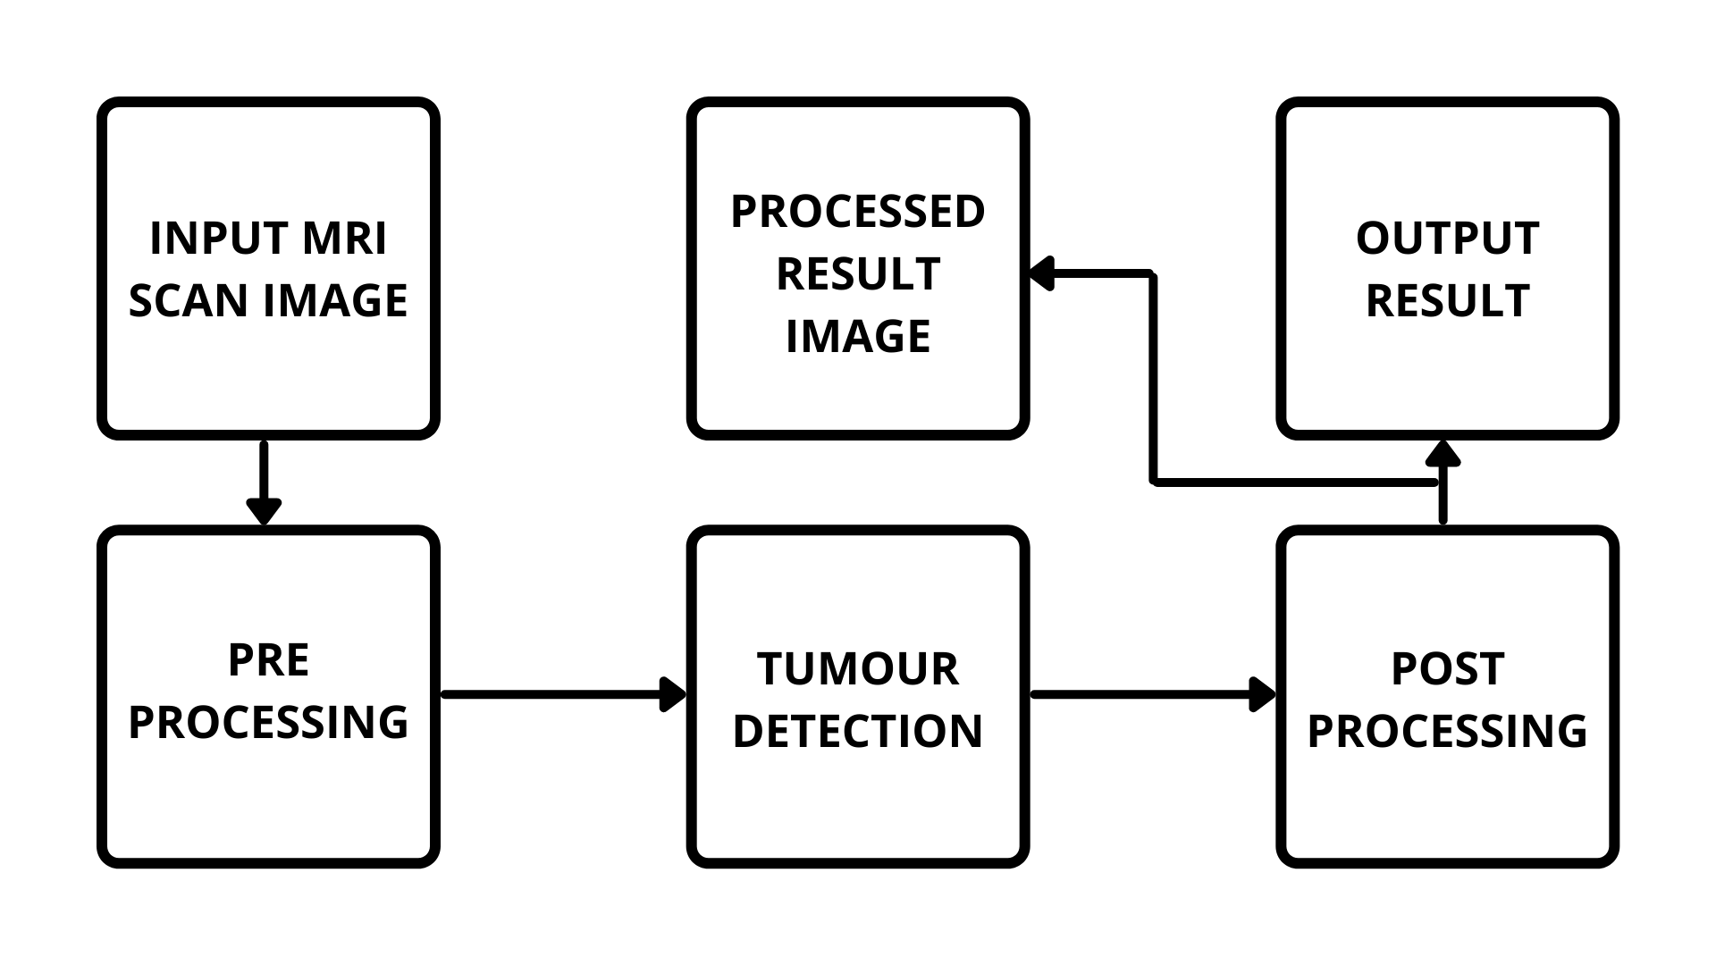
Proposed Methodology
Fig 2.- Proposed Block Diagram

Slide 9
Proposed Requirement analysis
Software Requirement
OS Requirement
Windows 8/10
Linux
Training of the model
Python IDE (Kaggle Notebook Editor)
Dataset for Training
Web Application

Slide 10
Proposed Requirement analysis
Hardware Requirement Basic Hardware for Training Purpose
RAM : 8 GB
ROM : 2 GB
Processor : i5 Processor
Limitations:
Limited detection due to less datasets being used in training.
Accuracy of Dataset is an important factor. Unverified datasets can lead to false results.
The detection model in it’s base form cannot provide accurate results on MRI captured using higher tesla MRI Machines.

Slide 11
Impact analysis
On Society
Positive Impact
Early detection may reduce Human Mortality Rate.
The system is affordable and easy to handle.
Negative Impact
It has a risk of errors and unplanned detection of false results.
It has a risk of undetected Initial stages due to small size.

Slide 12
Impact analysis
On Environment
Positive Impact
Less Bio Medical waste is generated due to early detection and treatment.
Negative Impact
Bio Medical waste generated during treatment after the detection of tumor is done through this system, if not treated properly can pose environmental risks.

Slide 13
Professional Ethical practices to be followed
Giving credits.
Keeping technical guidelines in mind.
Following the norms of engineering Practices.
Liability for outcome caused by one’s actions or decisions.

Slide 14
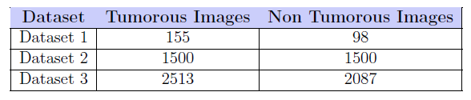
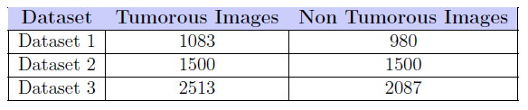
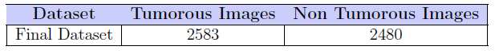
Results
Table 1.- Number of images in each dataset before augmentation
Table 2.- Number of images in each dataset after augmentation
Table 3.- Number of images in the final dataset after merging

Slide 15
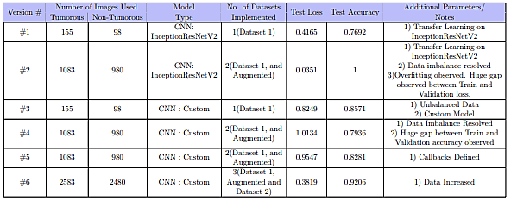
Results
Fig 3.- Results obtained from each version

Slide 16
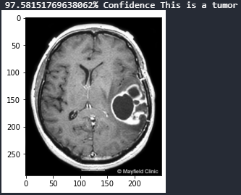
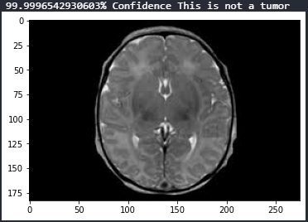
Results
Fig 4.- Presence of Brain Tumor
Fig 5.- Absence of Brain Tumor

Slide 17
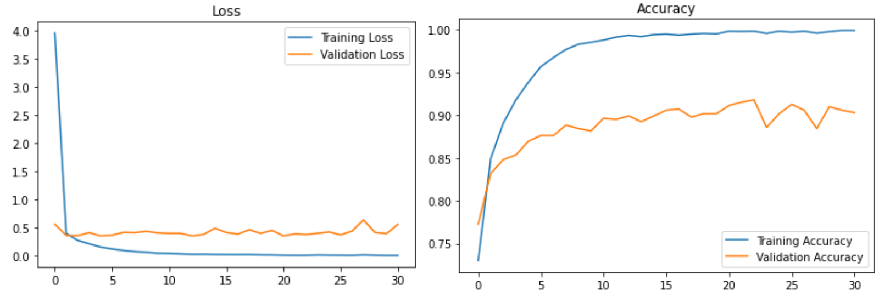
Results
Fig 6.- Loss and Accuracy Graph

Slide 18
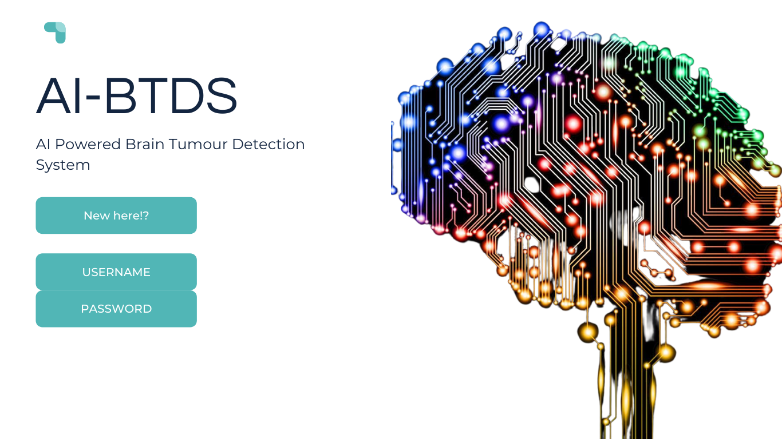
Proposed web Layout
Login Page

Slide 19
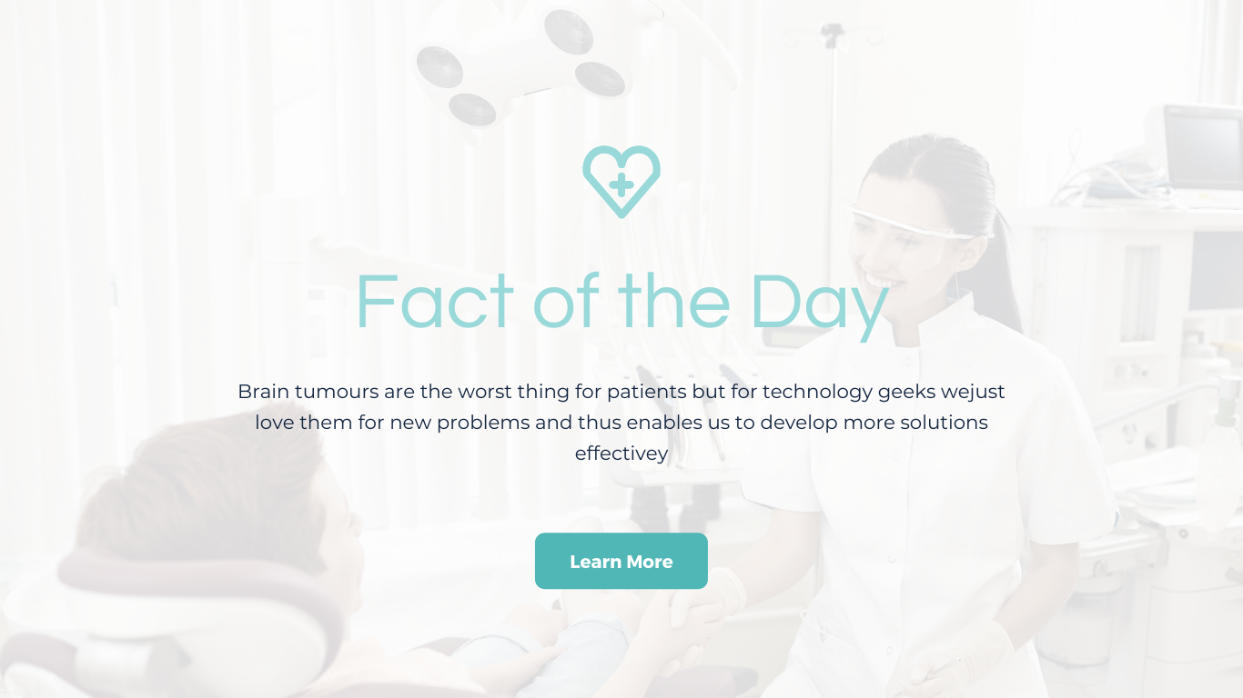
Proposed web Layout
Fact of the Day Page

Slide 20
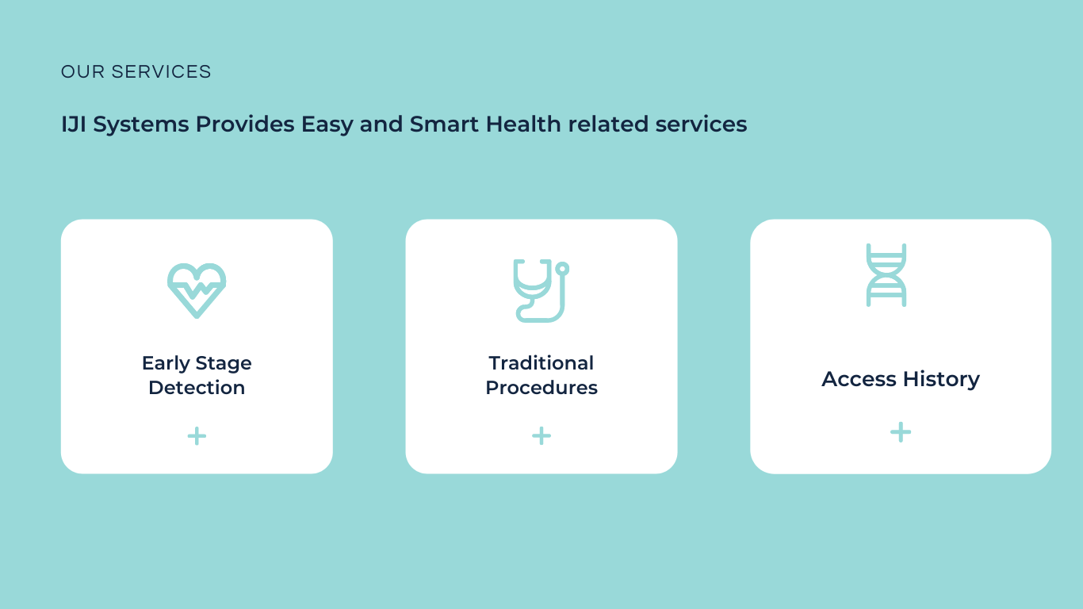
Proposed web Layout
Our Service Page

Slide 21
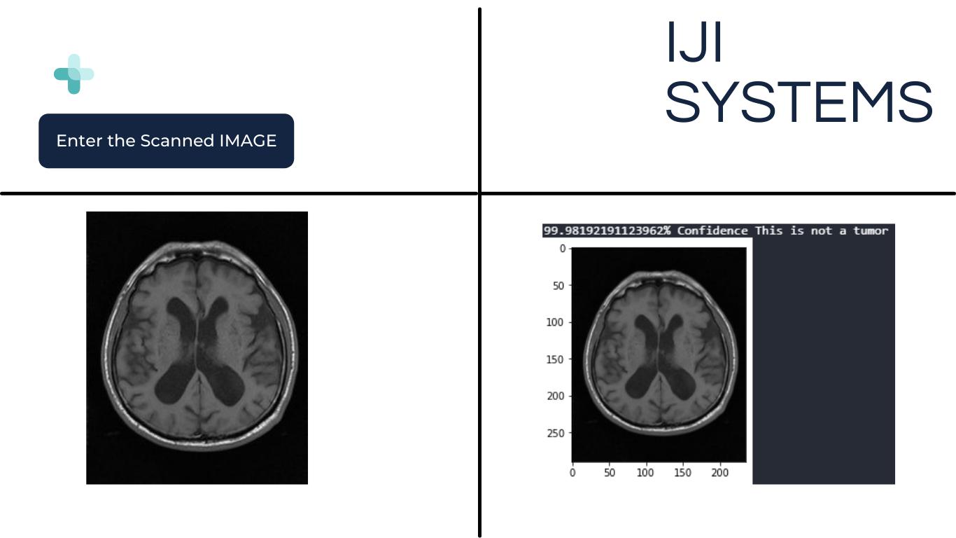
Proposed web Layout
Detection System Page

Slide 22

Proposed web Layout
Contact and Details page

Slide 23

Proposed web Layout
Contact and Details page

Slide 24
Conclusion
Implementation of a Deep Learning Model which detects whether there is brain tumor present or not is observed. A system accuracy of 92% is achieved on the trained model. Input image is passed onto the trained model which then determines whether image contains tumor or not. As per the inference by the model the output will be displayed on the web application accordingly.

Slide 25
Future Scope
• The particular trained model can be further trained to detect tumor of initial stages.
• The particular model can be trained further to detect which type of brain tumor is present inside the body.
• The system in its base form can be trained further to detect the tumor even more efficiently

Slide 26
Future Scope
• The entire Web Application can be further developed to understand more types of human body scans such as X-ray, CT - Scans etc. So as to become a full fledged health assessment portal.
• Such web application could be installed at hospitals which will then connect patients and the hospital staff virtually.
• The system can be upgraded to detect more types of tumors such as ovarian, breast, skin, lung tumors etc.

Slide 27
Reference Papers
[1] Avigyan Sinha, Aneesh R P, Malavika Suresh, Nitha Mohan R, Abinaya D, Ashwin G Singerji “Brain Tumour Detection Using Deep Learning“ Seventh International conference on Bio Signals, Images, and Instrumentation (ICBSII), 2021
[2] Pr Salander, A Tommy Bergenheim, Katarina Hamberg, Roger Henriksson , “Pathways from symptoms to medical care: a descriptive study of symptom development and obstacles to early diagnosis in brain tumor patients“ Family Practice, Volume 16, Issue 2, April 1999, Pages 143148
[3] McKinney PA, “Brain tumors: incidence, survival, and aetiology,“ Journal of Neurology, Neurosurgery & Psychiatry 2004
[4] Muhammad Waqas Nadeem, Mohammed A. Al Ghamdi, Muzammil Hussain, Muhammad Adnan Khan, Khalid Masood Khan, Sultan H. Almotiri and Suhail Ashfaq Butt, “Brain Tumor Analysis Empowered with Deep Learning: A Review, Taxonomy, and Future Challenges“ Brain Sci.2020
[5] Logeswari, T.; Karnan, M.“An improved implementation of brain tumor detection using segmentation based on hierarchical self organizing map.“ Int. J. Comput. Theory Eng. 2010, 2, 591.

Slide 28
Reference Papers
[6] Mansi Lathera, Dr. Parvinder Singh“Investigating Brain Tumor Segmentation and Detection Techniques “ International Conference on Computational Intelligence and Data Science (ICCIDS 2019) [7] Nandita Goyal and Dr. Bharti Sharma“Image Processing Techniques for Brain Tumor Identification“ IOP Conf. Ser.: Mater. Sci. Eng. 1022 012011
[8] Brain Tumor Detection using Image Processing by Saurabh Kumar , Iram Abid , Shubhi Garg , Anand Kumar Singh , Vivek Jain.//International Journal of Information Sciences and Application (IJISA). ISSN 0974-2255, Vol.11, No.1,2019
[9] Brain tumor segmentation based on deep learning and an attention mechanism using MRI multi‑modalities brain images by Ramin Ranjbarzadeh , Abbas Bagherian Kasgari , Saeid Jafarzadeh Ghoushchi , Shokofeh Anari , Maryam Naseri , Malika Bendechache //www.nature.com/scientificreports
[10] Isselmou Abd El Kader, Guizhi Xu, Zhang Shuai, Sani Saminu, Imran Javaid, Isah Salim Ahmad and Souha Kamhi“Brain Tumor Detection and Classification on MRI Images by a Deep Wavelet Auto-Encoder Model“ Diagnostics 2021

Slide 29
Thank You

